Slide 1
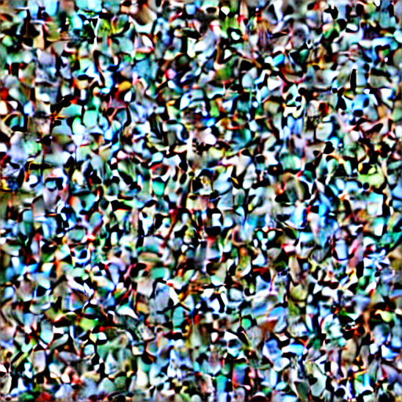

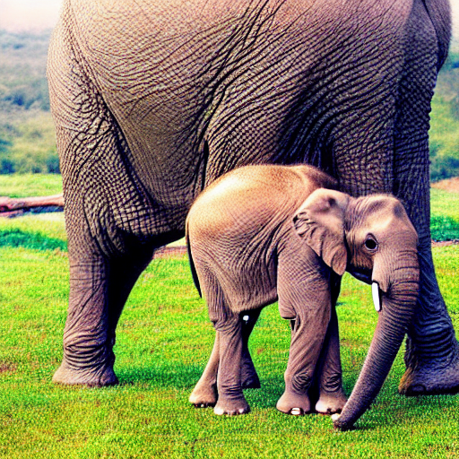
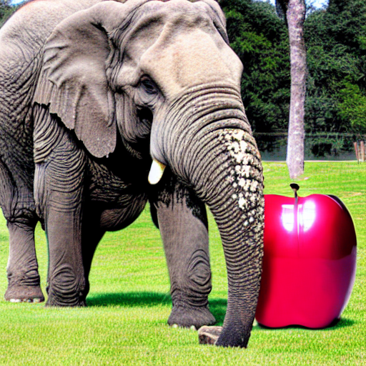
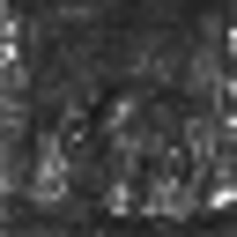
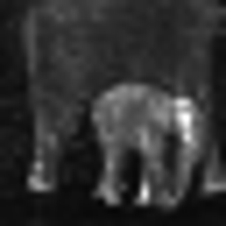
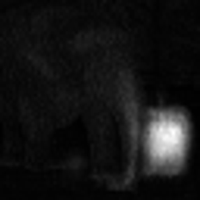
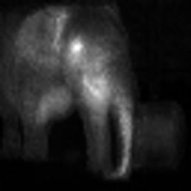


Denoise with a text prompt
Denoise with a text prompt
An elephant next to an apple.
An elephant next to an apple.
Stable Diffusion
Generated Image
Token Compose(Ours)
Generated Image
Cross
Attention Map
Cross
Attention Map
apple
elephant
apple
elephant

Slide 2
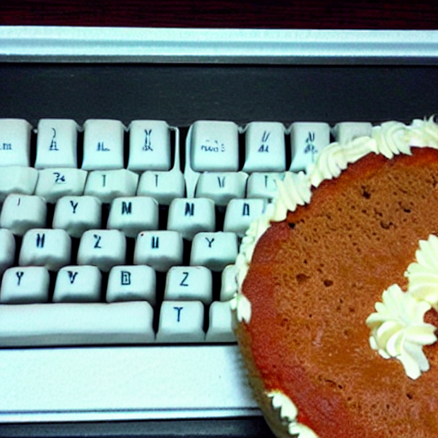
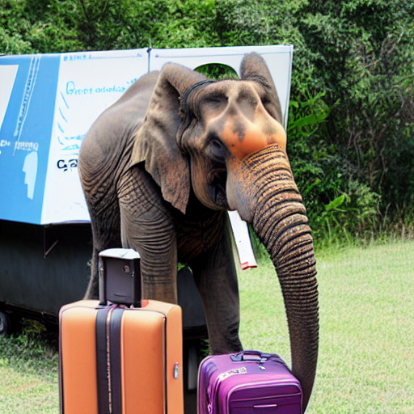
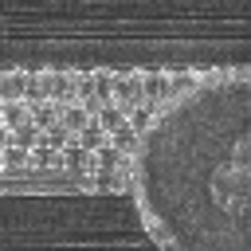
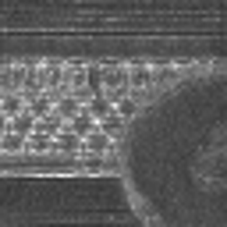
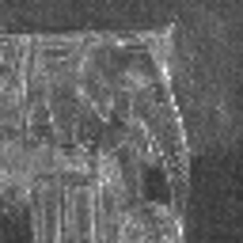
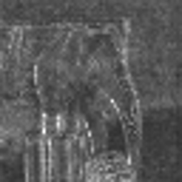
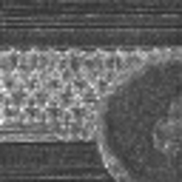
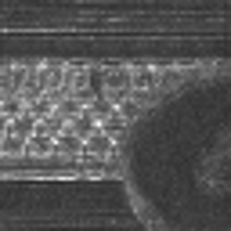
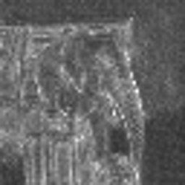
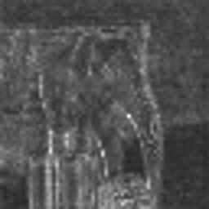
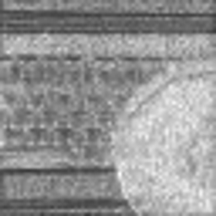
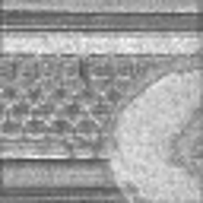
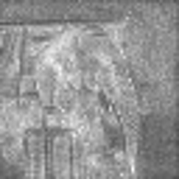
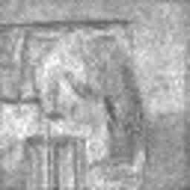
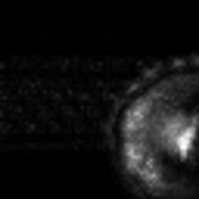
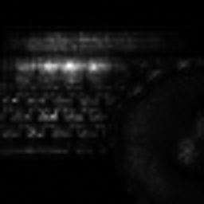
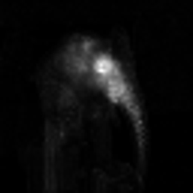
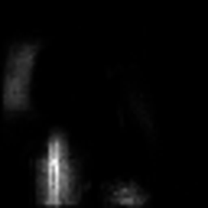
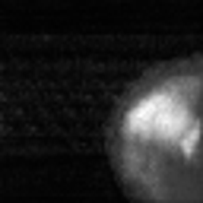
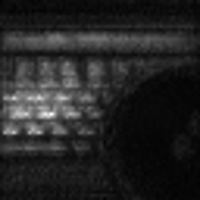
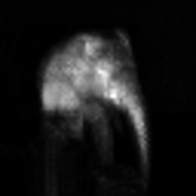
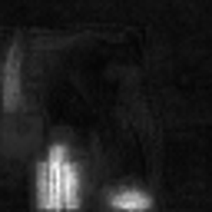
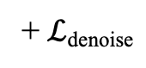
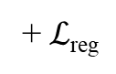
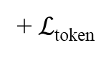
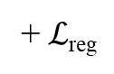
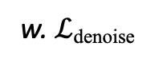
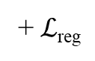
Prompt
A cake next to a keyboard.
An elephant standing next to a suitcase.
Generated Image
cake
keyboard
elephant
suitcase
Frozen
+ $ℒ$_{denoise}
w. $ℒ$_{denoise}
+ $ℒ$_{reg}
+ $ℒ$_{token}
+ $ℒ$_{reg}
+ $ℒ$_{reg}

Slide 3
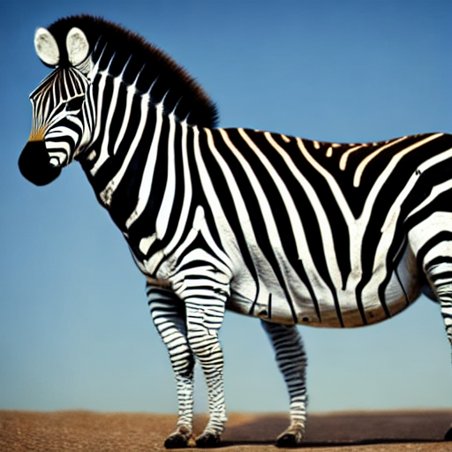
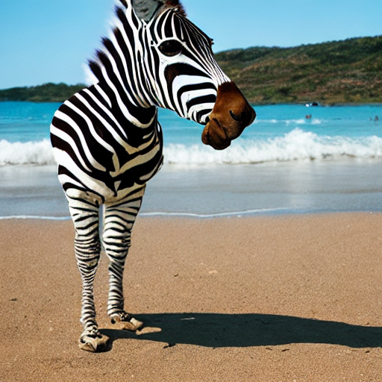
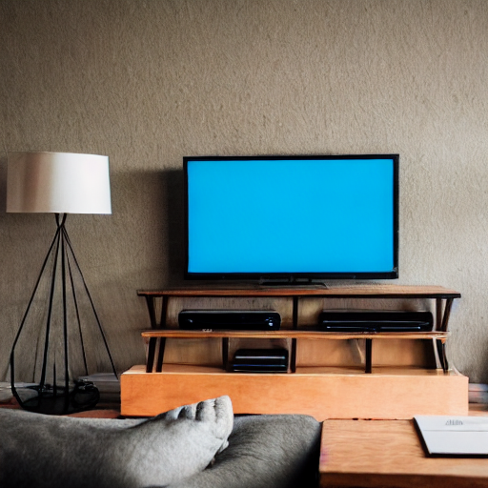
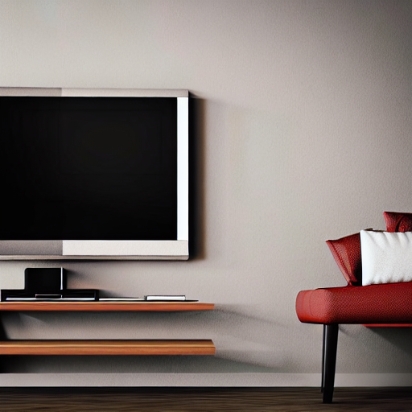
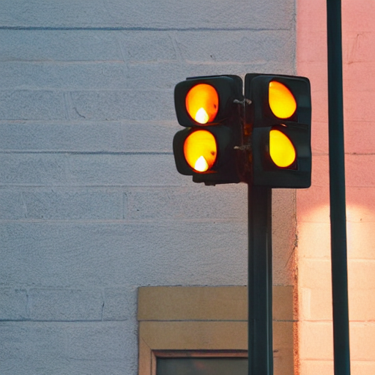
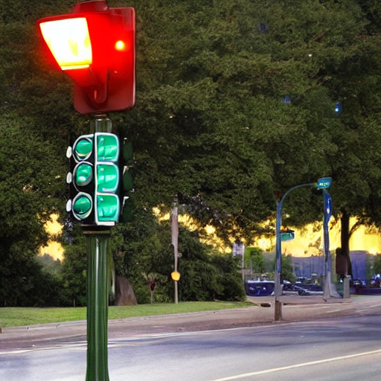
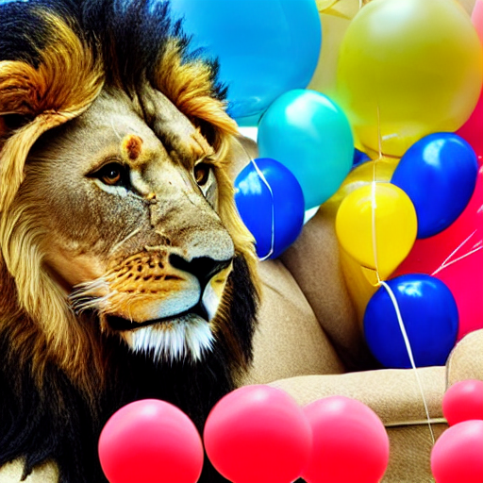
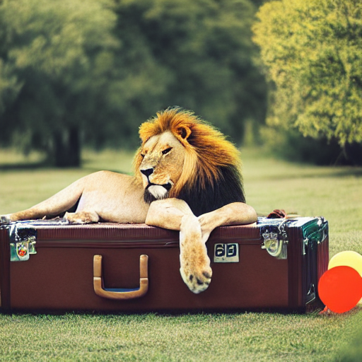
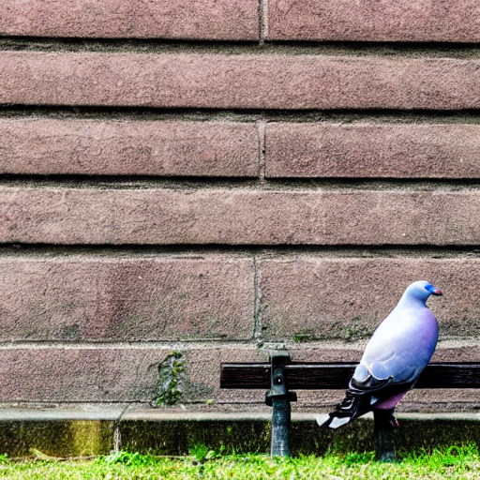
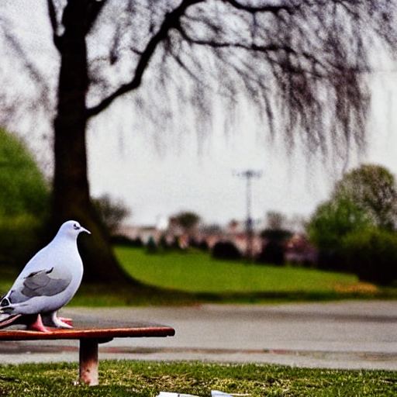
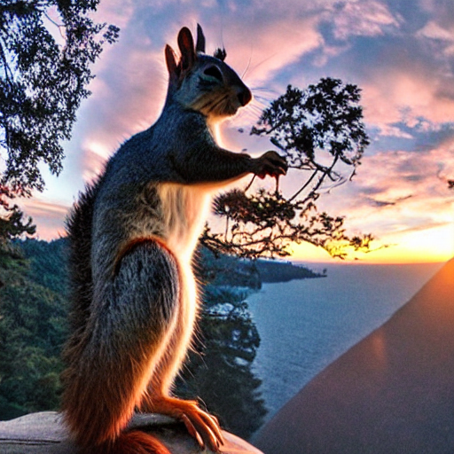
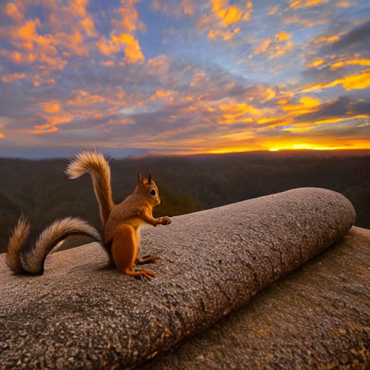
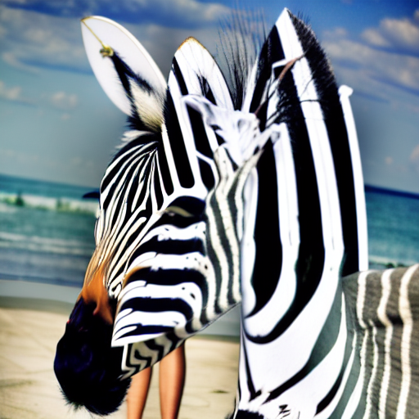
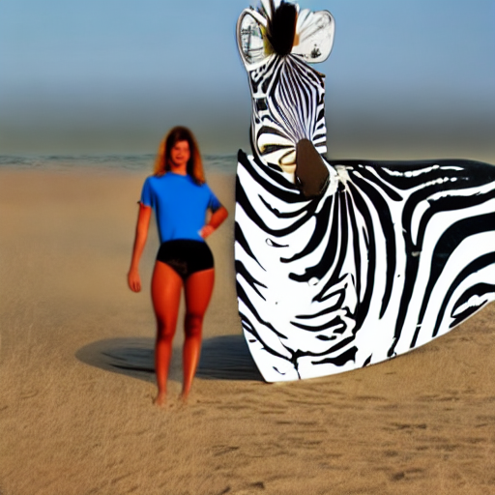
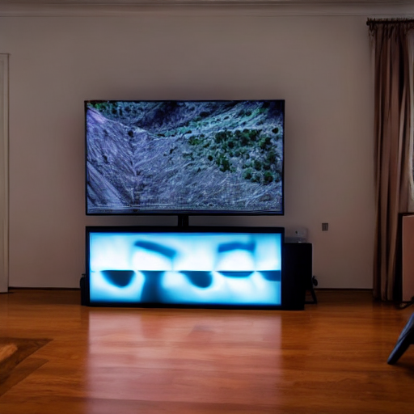

























































Figure 3
SD 1.4
Composable
Structured
Layout
Attend Excite
Token Compose
A zebra is standing next to a surfboard
A remote in front of a tv
A bed next to a traffic light
A lion rests beside a suitcase, surrounded by a cluster of balloons
A pigeon sitting on a bench reading a book
A squirrel wielding a camera documents the breathtaking scenery of a sunrise

Slide 4









Figure 5
Figure5 Token loss
Denoise with a text prompt
$ℒ$_{pixel} for each pixel:
$$Mlog\left(A\right)+\left(1−M\right)log⁡(1−A)$$
a small dog standing on a green bench with four people.
Cross Attention Map
dog
dog
U-Net
dog
Denoised Image
Pixel-wise
multi
Sum of Activations
Ground Truth Segmentation Mask
Sum of Activations
$ℒ$_{token} $for each token: {(1−\frac{Inside Segmentation Sum}{All Area Sum})}^{2}$

Slide 5



Figure 1 backup
把这边这个给我改好
Denoise with a text prompt
Denoise with a text prompt
An elephant next to an apple.
A keyboard and a mouse.
A keyboard and a mouse.
Stable Diffusion
Generated Image
Stable Diffusion
Generated Image
Cross
Attention Map
Cross
Attention Map
keyboard
mouse
apple
elephant
keyboard
mouse

Slide 6



































Figure4

Slide 7










































SD 1.4
Composable
Structured
Layout
Attend Excite
Token Compose
a zebra is standing next to a surfboard
a remote in front of a tv
a carrot next to a cup
an airplane behind a motorcycle
a clock near a chair
a lion rests beside a suitcase, surrounded by a cluster of balloons
a bird standing on a bench, with a bottle next to it
a pigeon sitting on a bench reading a book
a squirrel wielding a camera documents the breathtaking scenery of a sunrise
a swan standing on a dining table watching a cake
a beaver riding a motorcycle, surrounded by pizzas
a snowman sitting next to a campfire, looking at a hamburger

